Slide 1


Titolo presentazione sottotitolo
Recovering ECDSA nonce with partial information
Milano, XX mese 20XX
Federico Zanca

Slide 2

ECDSA (Elliptic Curve Digital Signature Algorithm)
Parameters: Elliptic curve $$E$$,generator point $$G$$ on $$E$$ of order $$n$$
Private Key: integer $$d$$
Public Key: Curve point $$Q=dG$$
Sign message $$m$$:
Hash the message $$h=H(m)$$
Randomly pick a nonce $$k$$
Compute
$$r={(kG)}_{x }mod n$$
$$s=k^{-1}(h+dr) mod n$$
Signature is $$( r , s )$$

Slide 3
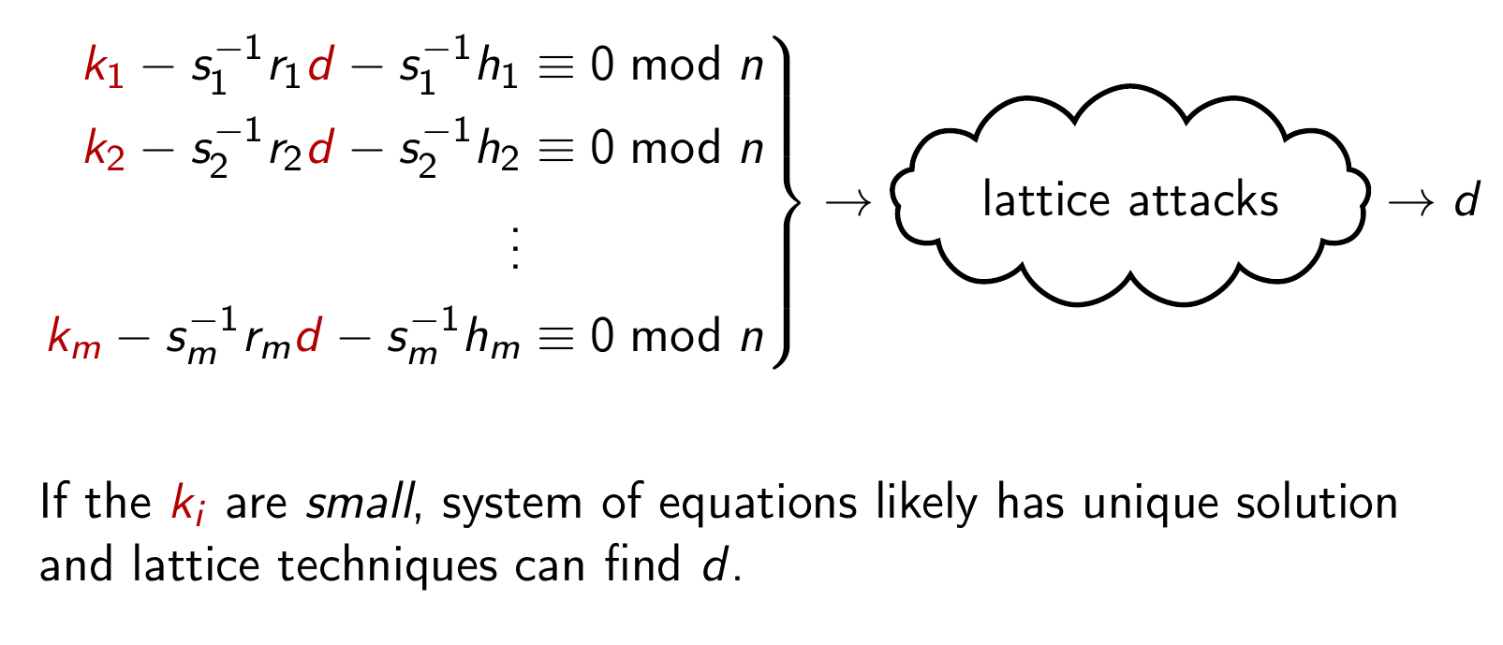
Nonce recovery and ECDSA security
$$k$$ must be generated uniformly at random,
or we can use many signatures to compute the private key $$d$$
$$d=\left(sk−h\right)r^{-1} mod n$$

Slide 4
Nonce recovery and ECDSA security
Partial information on specific bits of the nonce can be recovered via side-channel attacks
MOD not running in constant time (if < n the function return early)
Scalar multiplication of points on EC not running in constant time
Many more...

Slide 5
Firma convenzione Politecnico di Milano e Veneranda Fabbrica del Duomo di Milano
Mathematical Background
Lattices, lattice problems, lattice reduction
Aula Magna – Rettorato
Mercoledì 27 maggio 2015

Slide 6
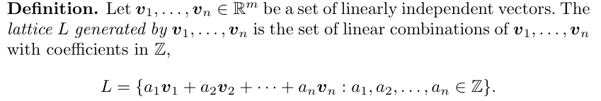
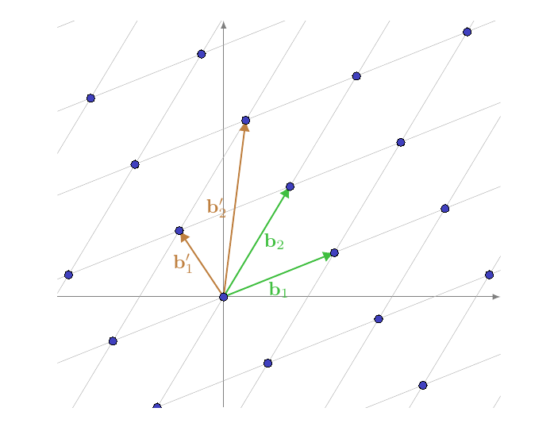
Lattices
A basis for $$L$$is any set of independent vectors that generates $$L$$
Although a lattice can be represented by many different bases, some are particularly “good” for solving certain computational problems
A 2-dimensional lattice and two different bases for it

Slide 7
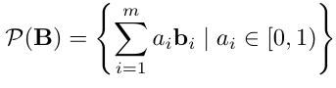
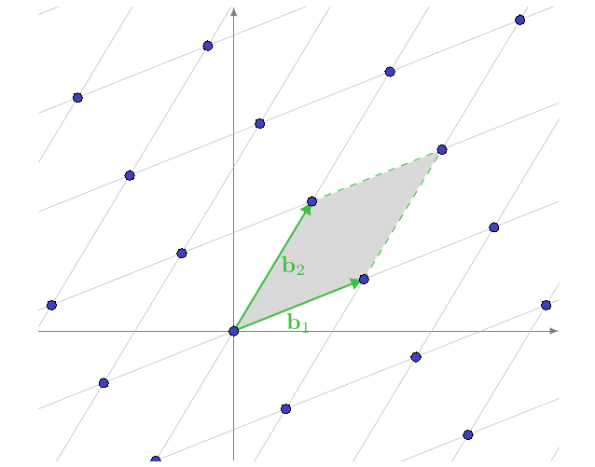

Lattices
Definition (Fundamental Domain). Let $$B=\{b_{1},...,b_{m}\}$$ be a basis. The fundamental domain (or parallelepiped) of B is defined as
A basis B is a basis for the lattice L iff L = {0}

Slide 8
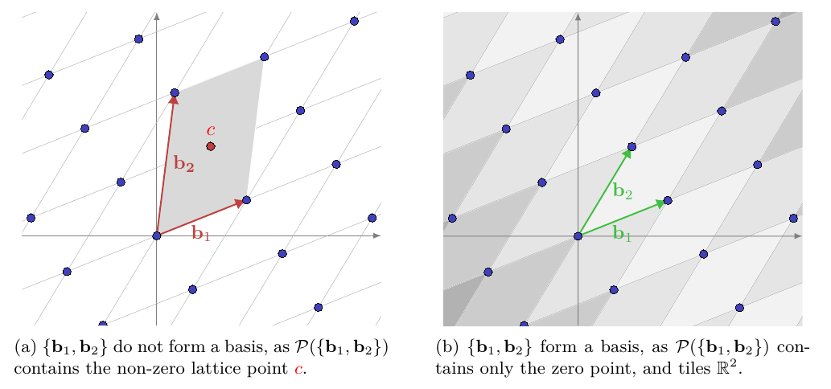
Lattices
A basis B is a basis for the lattice L iff L = {0}

Slide 9
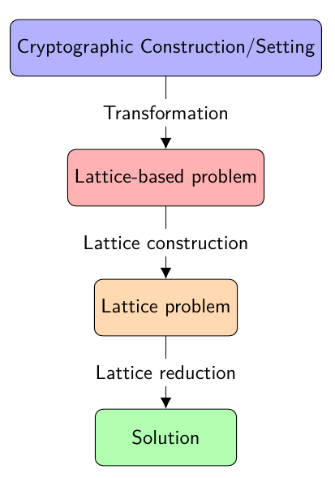
Lattices for cryptanalysis

Slide 10
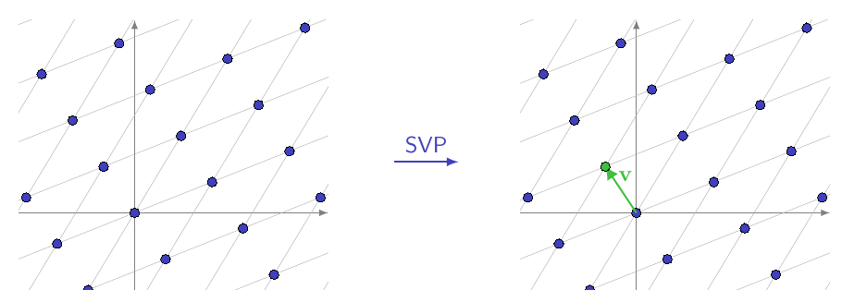
Shortest Vector Problem - SVP
Given a basis B, find a shortest non-zero vector $$v ∈ L$$ that minimizes $$||v||$$

Slide 11
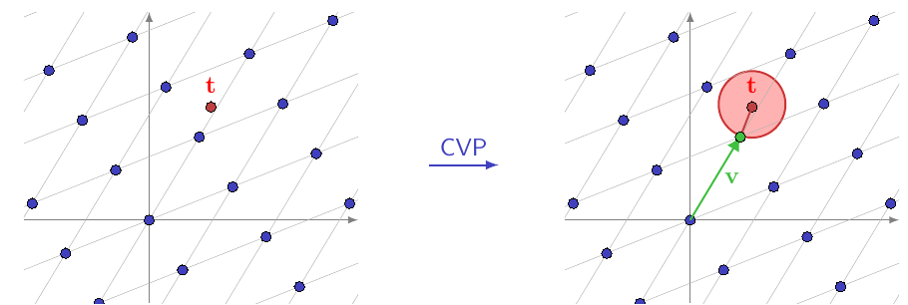
Closest Vector Problem - CVP
Given a basis B of a lattice L, and a target vector t (not necessarily in L), find a lattice vector $$v$$ that satisfies $$||v-t||=\min_{w ∈ L}||w-t||$$
It is well-known that these problems are NP-Hard

Slide 12
apprSVP and apprCVP
Approximate Shortest Vector Problem ($${SVP}_{γ})$$
Given a basis B of a lattice L find a non-zero lattice vector $$v$$that satisfies $$||v||≤γλ_{1}(L)$$
Approximate Closest Vector Problem ($${SVP}_{γ})$$
Given a basis B of a lattice L and a target vector t and an approximation factor $$γ$$, find a lattice vector $$v$$ that satisfies $$||v-t||≤{γ∙min}_{w ∈ L}||w-t||$$
Lattice Reduction is used to solve these problems.
Main idea: transform an arbitrary lattice basis into a “better” basis that contains shorter and more orthogonal vectors.

Slide 13
Lattice reduction algorithms
Main idea: transform an arbitrary lattice basis into a “better” basis that contains shorter and more orthogonal vectors.
LLL and BKZ (LLL generalization) solve SVP
CVP can be solved using Babai’s algorithm or Kannan’s embedding method (transforms CVP in SVP with +1 dimensions)

Slide 14
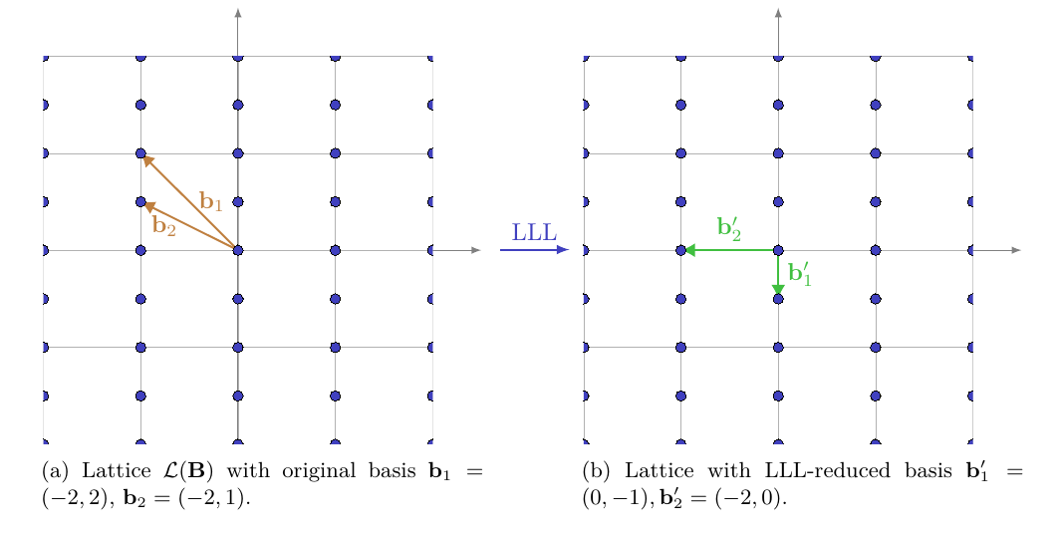

LLL (Lenstra-Lenstra-Lovász algorithm)
LLL solves apprSVP/apprCVP within an approximation factor exponential in the dimension of the lattice to the shortest vector in polynomial time $$||v||≤C^{n}||{v||}_{shortest}$$
In practice: $$||v||≤{1.02}^{n}{(det L)}^{1/n}$$
Reduction algorithms like LLL transform a basis B for a lattice L into a “better” basis: vectors should be as short as possible and as orthogonal as possible to one another

Slide 15
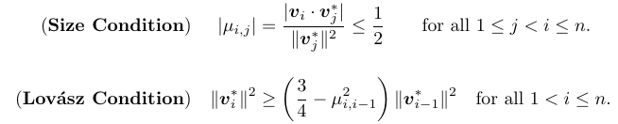
LLL the actual algorithm
Definition Let $$B=\{v_{1},...,v_{n}\}$$ be a basis for a lattice L and let $$B^{*}=\{v_{1}^{*},...v_{n}^{*}\}$$ be the associated Gram-Schmidt orthogonal basis. B is said to be LLL reduced if it satisfies the following two conditions:
2 crucial steps in the algorithm:
Size reduction step
it aims to make the current basis vector $$b_{i}$$​ smaller in the direction of the previous basis vector $$b_{i-1}$$
Swap step
ensures that the basis vectors satisfy the Lovász condition, which is necessary to maintain progress towards finding a reduced basis

Slide 16
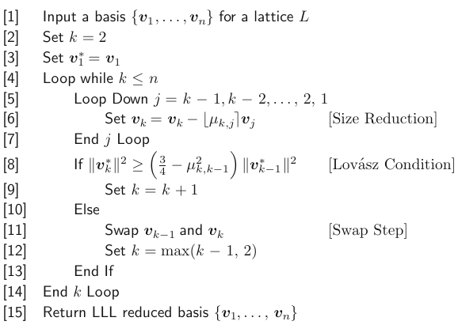
LLL the actual algorithm
Size reduction step: we do this by subtracting from $$v_{k}$$ appropriate integer multiples
($$μ_{i,j} rounded to the closest integer)$$ of the previous vectors $$v_{1},...,v_{k-1}$$ so as to make $$v_{k}$$ smaller.
After size reduction check if Lovász condition is satisfied.
If it is, we have a nearly optimal ordering of the vectors.
If not, reorder the vectors and do further size reduction.
Note: at each step $$v_{1}^{*},...,v_{k}^{*}$$ is the orthogonal set of vectors obtained by applying Gram-Schmidt to the current values of $$v_{1},...,v_{k}$$ and $$μ_{i,j}$$= $$\frac{v_{i}∙v_{j}^{*}}{{||v_{j}^{*}||}^{2}}$$

Slide 17
BKZ-LLL block Korkin-Zolotarev LLL
The block Korkin–Zolotarev variant of the LLL algorithm replaces the swap step in the standard LLL algorithm by a block reduction step (block of size β) to achieve a more global reduction across the entire basis.
LLL works with β=2 (performs reduction working on pairs of vectors).
BKZ-LLL works with a block of vectors of length β
$$v_{k},v_{k+1},...,v_{k+β-1}$$
and replaces them with a KZ-reduced basis spanning the same sublattice.

Slide 18
Kannan’s embedding method
Express a CVP problem as a SVP instance to solve it
Basis: $$B=\{b_{1},...,b_{n}\}$$
Target vector $$t=(t_{1},...,t_{n})$$
Solution to CVP problem: $$c_{1}b_{1}+c_{2}b_{2}+...+c_{n}b_{n}$$
Then we have $$t≈\sum_{i=1}^{n}{c_{i}b_{i }}\overset{⇒}{ } t=\sum_{i=1}^{n}{c_{i}b_{i}+e}$$ where $$||e||$$is small.
Hence, consider the $$n+1$$ dimensional lattice with basis
$$B^{'}=\left[\begin{matrix}B & 0 \\ t & q\end{matrix}\right]$$
which contains the short vector (e, q) by the linear combination $$(-c_{1},...,-c_{n}, 1)$$
The solution is given by subtracting e from t

Slide 19
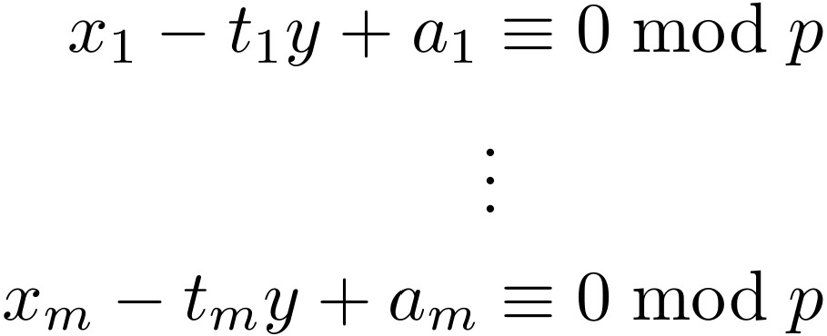
HNP Hidden Number Problem
Secret integer $$α$$mod $$p$$
Known $$m$$ pairs of integers $${ \{(t_{i}, a_{i})\}}_{i=1}^{m}$$ such that
$$t_{i}α-a_{i}=b_{i} mod p$$
with $$|b_{i}|<B$$ for some $$B<p$$
Reformulate as seeking a solution $$x_{i}=b_{i} , y=α$$ to the unconstrained system
This is solvable by solving CVP with lattices
It’s easier to solve SVP so express it as an SVP instance

Slide 20
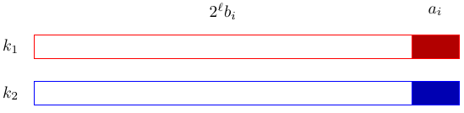
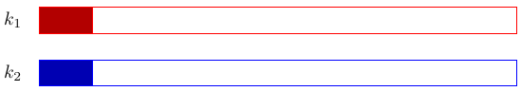
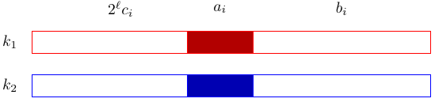
ECDSA as HNP instance
Formulate the ECDSA key recovery problem as an instance of the Hidden Number Problem and compute the shortest vector of a specially constructed lattice to obtain the solution
Assumption: the attacker has access to multiple signatures and hashes of the messages

Slide 21
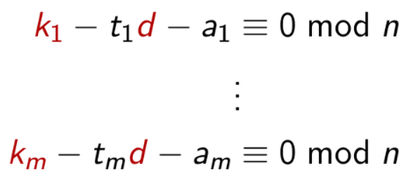
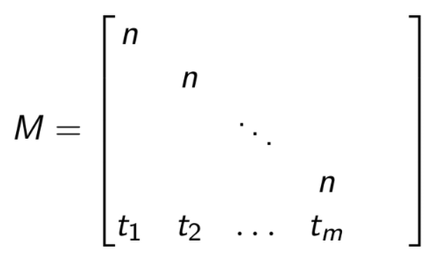
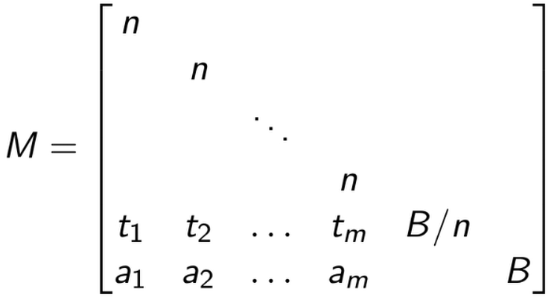
ECDSA as HNP instance
Construct the lattice basis
in unknowns $$k_{i}$$ , $$d$$ where $$|k_{i}|<B$$
$$t_{i}={s_{i}}^{-1}r_{i}$$ $$a_{i}={s_{i}}^{-1}h_{i}$$
Solve CVP with target vector $$v_{t}=(a_{1},a_{2},...,a_{m})$$ using Kannan’s embedding
$$v_{k}=(k_{1},k_{2},...,k_{m})$$ will be the distance
$$v_{k}=(k_{1},k_{2},...,k_{m},\frac{Bd}{n},B)$$ is a short vector in this lattice
Assumption: $$k_{i}$$ are small
(which means MSB = 0)

Slide 22
Known nonzero MSB
If MSB of $$k_{i}$$ are nonzero and known, we can write $$k_{i}=(x_{i}+y_{i})$$ where $$x_{i}$$ is the leak (left shifted) and $${|y}_{i}|<K$$.
Then $$k-td-a≡0 mod n$$ becomes
$$(x+y)-td-a≡0 mod n$$
$$y-td-u≡0 mod n$$
where $$u=s^{-1}h-x$$
This is again an instance of HNP and $$y$$ is small

Slide 23
Known nonzero LSB
If LSB of $$k_{i}$$ are nonzero and known, we can write $$k_{i}=(y_{i}+2^{l}x_{i})$$ where $$x_{i}$$ is the leak, $$l$$ is the size of the leak and $${|y}_{i}|<K$$.
Then $$k-td-a≡0 mod n$$ becomes
$$(y+2^{l}x)-td-a≡0 mod n$$
$$y-td-u≡0 mod n$$
where $$u=s^{-1}h-2^{l}x$$
Once again, solve HNP as before and retrieve the key

Slide 24
Known middle bits
This is more complex, since we have two unknown chunks of the nonce to recover per signature. A generally larger leak is needed too.
Given two signatures generated with the same private key, the nonces satisfy
$$k_{i}+tk_{2}+u≡0 mod n$$
where $$t=-{s_{1}}^{-1}s_{2}r_{1}{r_{2}}^{-1}$$ and $$u={s_{1}}^{-1}r_{1}h_{2}{r_{2}}^{-1}-{s_{1}}^{-1}h_{1}$$
Since we know the middle bits (shifted) of $$k_{1}$$ and $$k_{2}$$ are $$a_{1}$$and $$a_{2}$$ respectively, we can write
$$k_{1}=a_{1}+b_{1}+2^{l}c_{1}$$ and $$k_{2}=a_{2}+b_{2}+2^{l}c_{2}$$
where $$b_{1}$$, $$c_{1}$$, $$b_{2}$$, $$c_{2}$$ are unknown but small, less than some bound K and l is the size of the leak

Slide 25
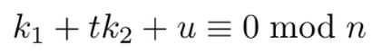



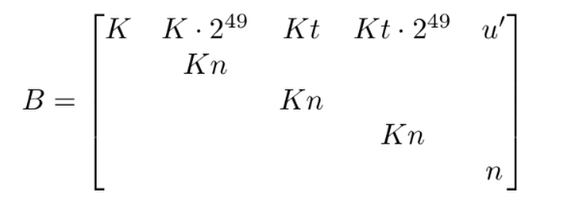
Known middle bits
Running BKZ on B we obtain a basis containing the vector $$v=(z_{1}K, {-z}_{2}K, z_{3}K, z_{4}K,-z_{5})$$
This corresponds to the linear equation
$$z_{1}x_{1}-z_{2}y_{1}+z_{3}x_{2}+z_{4}y_{2}-z_{5}=0$$
$$\left[\begin{matrix}K & K2^{l} Kt Kt2^{l} & u^{'} \\ ⋮ & Kn & ⋮ \\ & & \end{matrix}\right]$$
Do the same for the next three short vectors in the basis, solve the system and retrieve
$$x_{1} ,{ y}_{1} ,{ x}_{2} , y_{2}$$

Slide 26
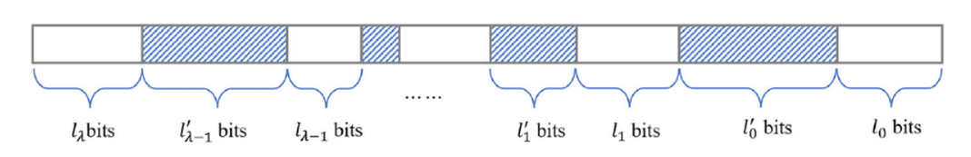
Generalization of the attack
It is possible to retrieve the key starting from chunks of bits in arbitrary positions of the nonce solving an instance of the Extended Hidden Number Problem
$$\left[\begin{matrix}K & K2^{l} Kt Kt2^{l} & u^{'} \\ ⋮ & Kn & ⋮ \\ & & \end{matrix}\right]$$

Slide 27
References
Survey: Recovering cryptographic keys from partial information
Biased Nonce Sense: Lattice Attacks against Weak ECDSA Signatures in Cryptocurrencies
Return of the Hidden Number Problem
Improved Attacks on (EC)DSA with Nonce Leakage by by Lattice Sieving
A Gentle Tutorial for Lattice-Based Cryptanalysis
An Introduction to Mathematical Cryptography
$$\left[\begin{matrix}K & K2^{l} Kt Kt2^{l} & u^{'} \\ ⋮ & Kn & ⋮ \\ & & \end{matrix}\right]$$

